Slide 1
Machine Learning CS 559 – Final Project
Predict a building's Energy Star score to analyze its energy performance
- Sonam De

Slide 2
Dataset Information
Building energy data from New York City.
Source: https://www1.nyc.gov/html/gbee/html/plan/ll84_scores.shtml
The target column:
ENERGY STAR score helps to assess how the building is performing. It helps to identify which buildings to target for improvement or recognition. A score of 50 is the median. So if a building scores below 50, it means it’s performing worse than 50 percent of similar buildings nationwide, while a score above 50 means it’s performing better than 50 percent of its peers. And a score of 75 or higher means it’s a top performer and may be eligible for ENERGY STAR certification.
A 1-to-100 percentile ranking based on self-reported energy usage for the reporting year. The Energy Star score is a relative measure used for comparing the energy efficiency of buildings.

Slide 3
Objective and Methods
Objective:
To use the energy data to build a model that can predict the Energy Star Score of a building and interpret the results to find the factors which influence the score.
Methods:
Supervised: we have access to both the features and the target and our goal is to train a model that can learn a mapping between the two
Regression: The Energy Star score is a continuous variable
Naïve KNN
Cross Validation K fold Model

Slide 4
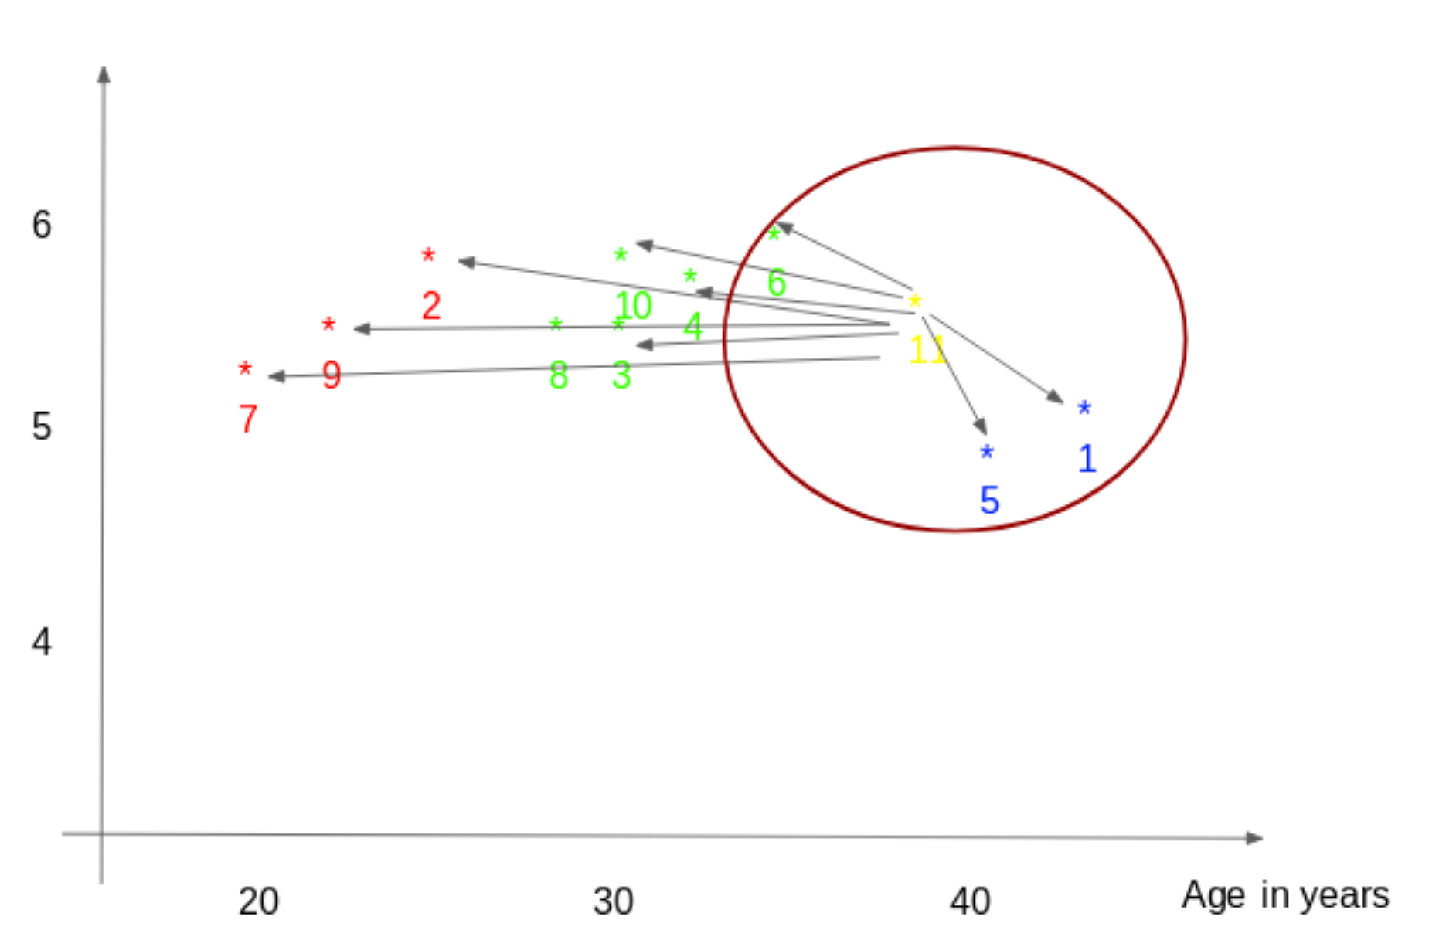
KNN Regression - How it works:
Weight | Age
170 | 50
180 | 52
122 | 23
156 | 43
217 | 59
The question is: how old is someone given they weigh 175 pounds?
Suppose k = 3. We find the three nearest neighbors to 175. They are:
(170,50)
(180,52)
(156,43)
We take the average of the target variable:
Average = (50 + 52 + 43) / 3 = 48.3
STEPS:
Compute the distance to every training instance
Select the k closest instances and the values of their target variables
Output the mean of the values of the target variables

Slide 5
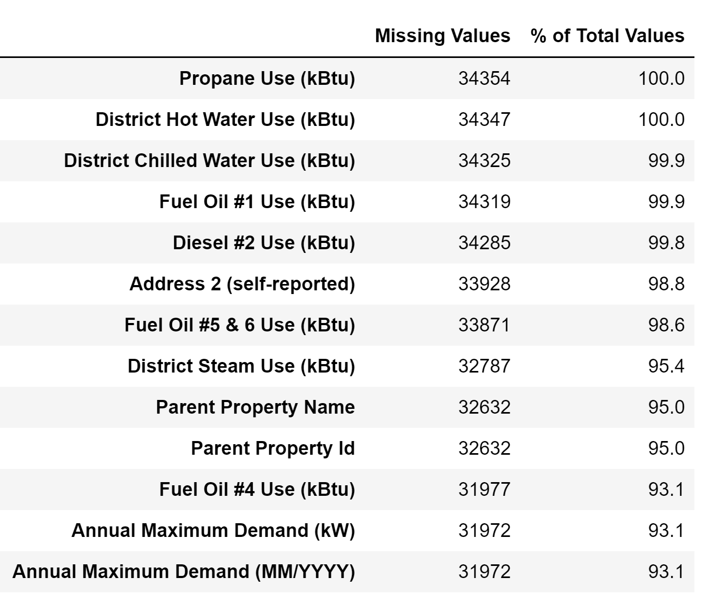
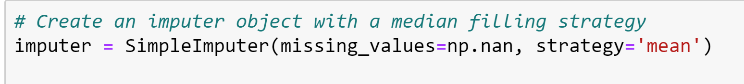
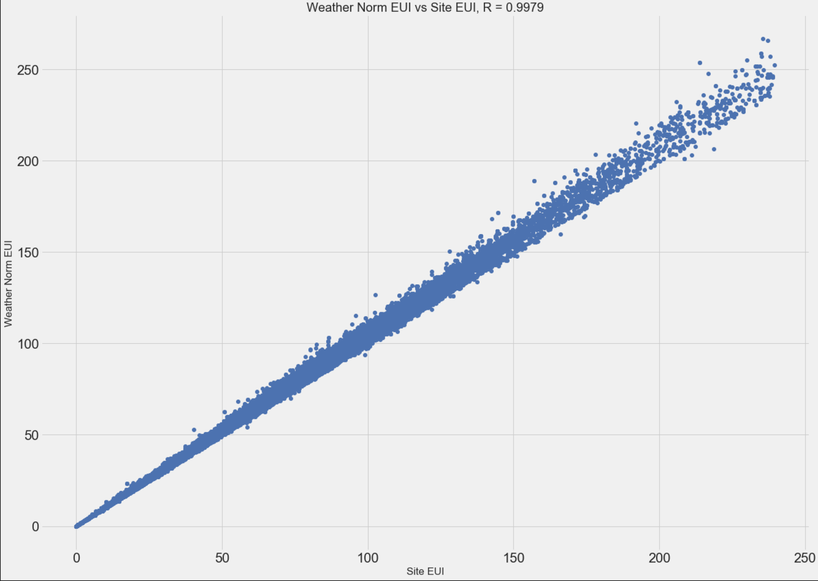
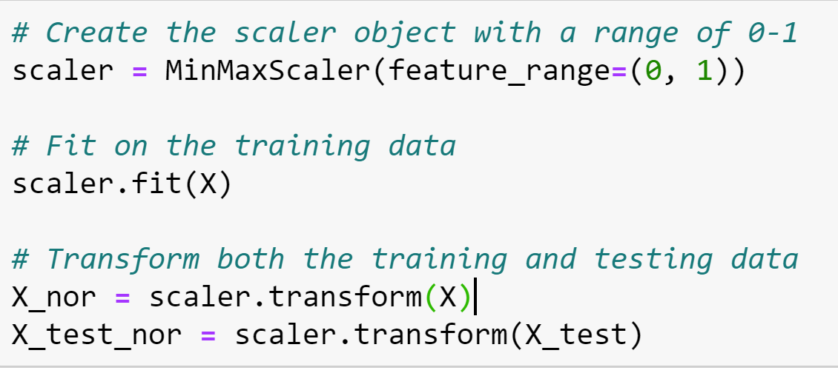
Steps performed in pre- processing of data:
Data types - Convert Data to Correct Types
Analyzing missing values – removing those features
which have more than 70% of the data missing.
Removed Collinear Features
Fill missing values using sklearn imputer function
Scaling of the features

Slide 6
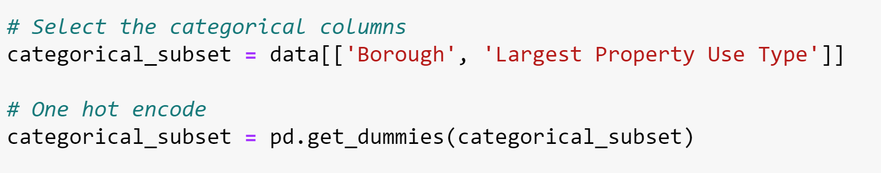
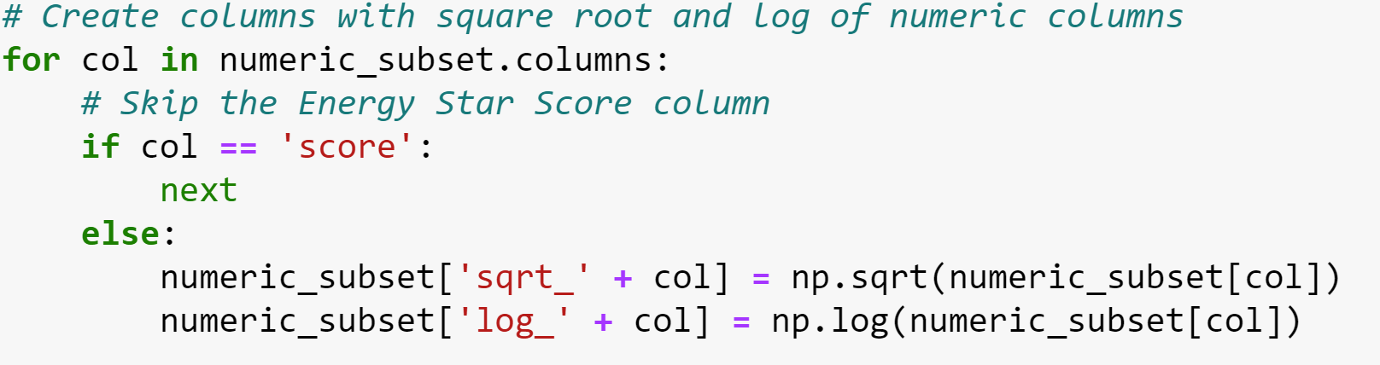
Feature Engineering and Feature selections:
Did One- hot encoding for categorical columns
Log transformation of the numeric columns

Slide 7
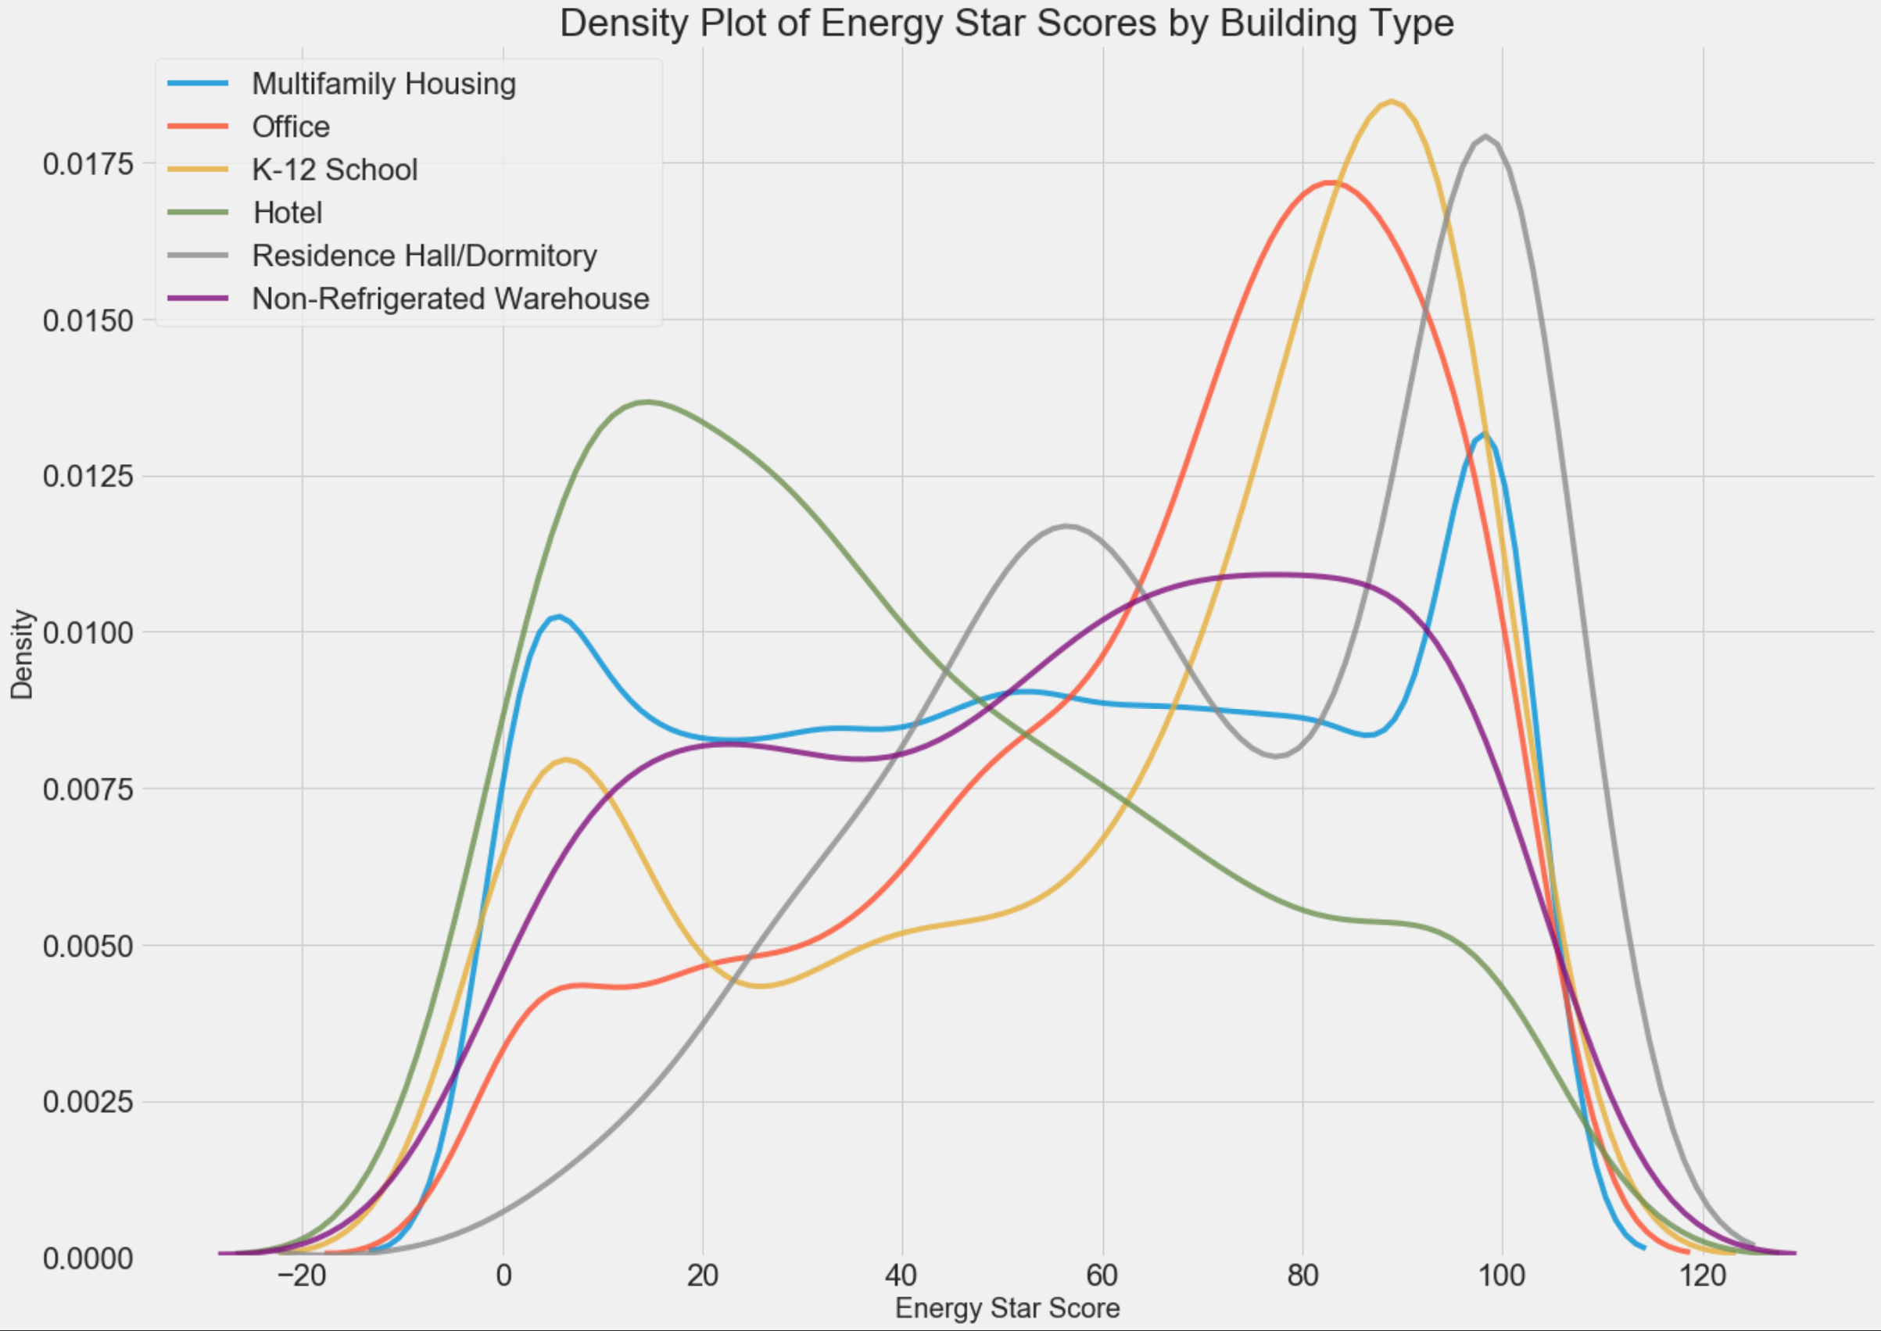
Density Plot -Energy Star Scores by Building Type
Building type does have an effect on the score
Change in Energy Star score distribution for different building types

Slide 8
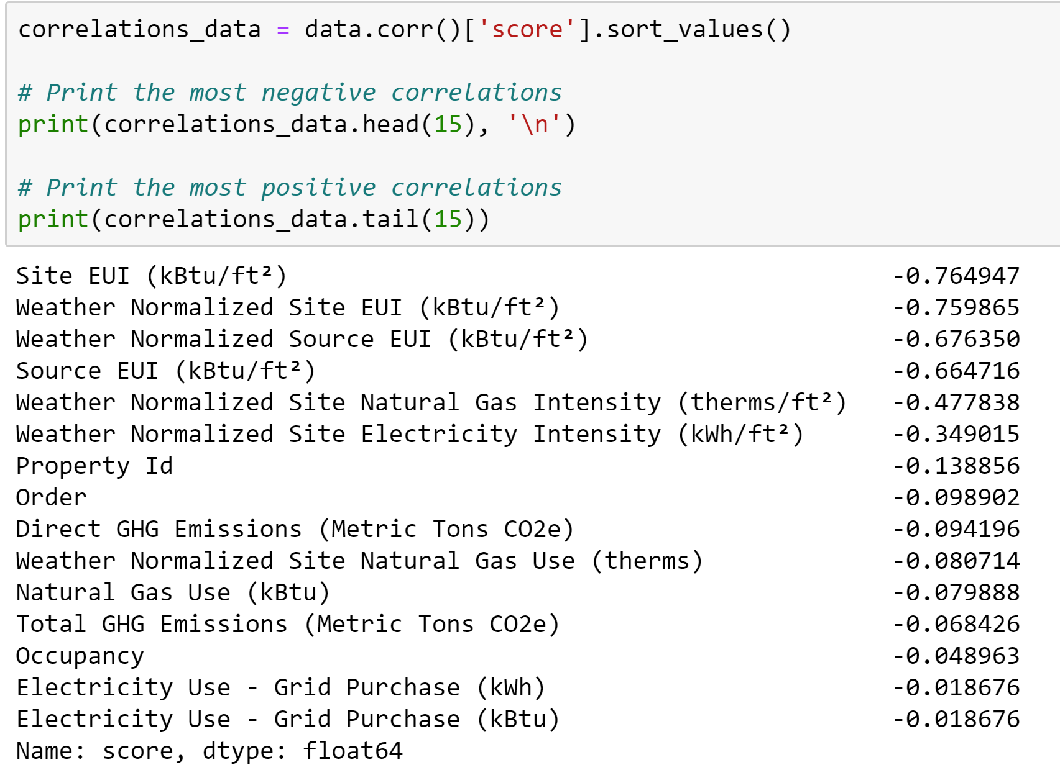
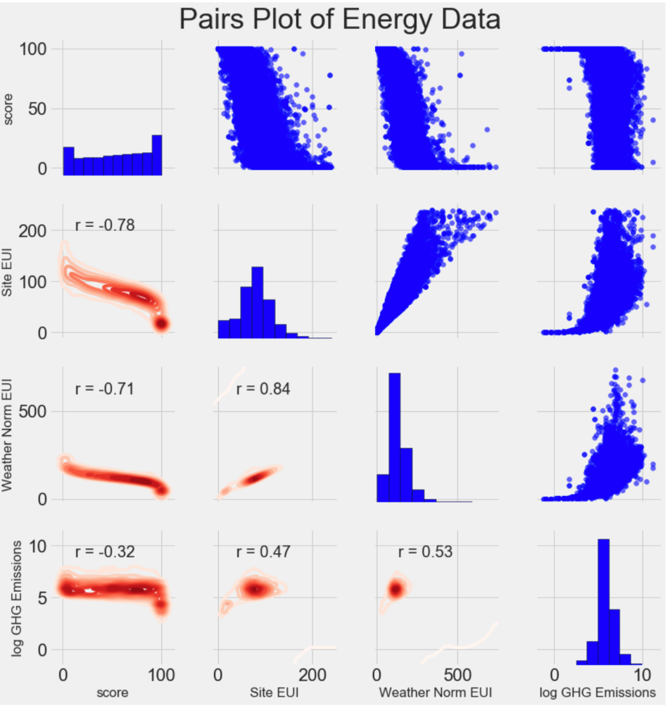
Correlations between Features and Target(energy score)

Slide 9
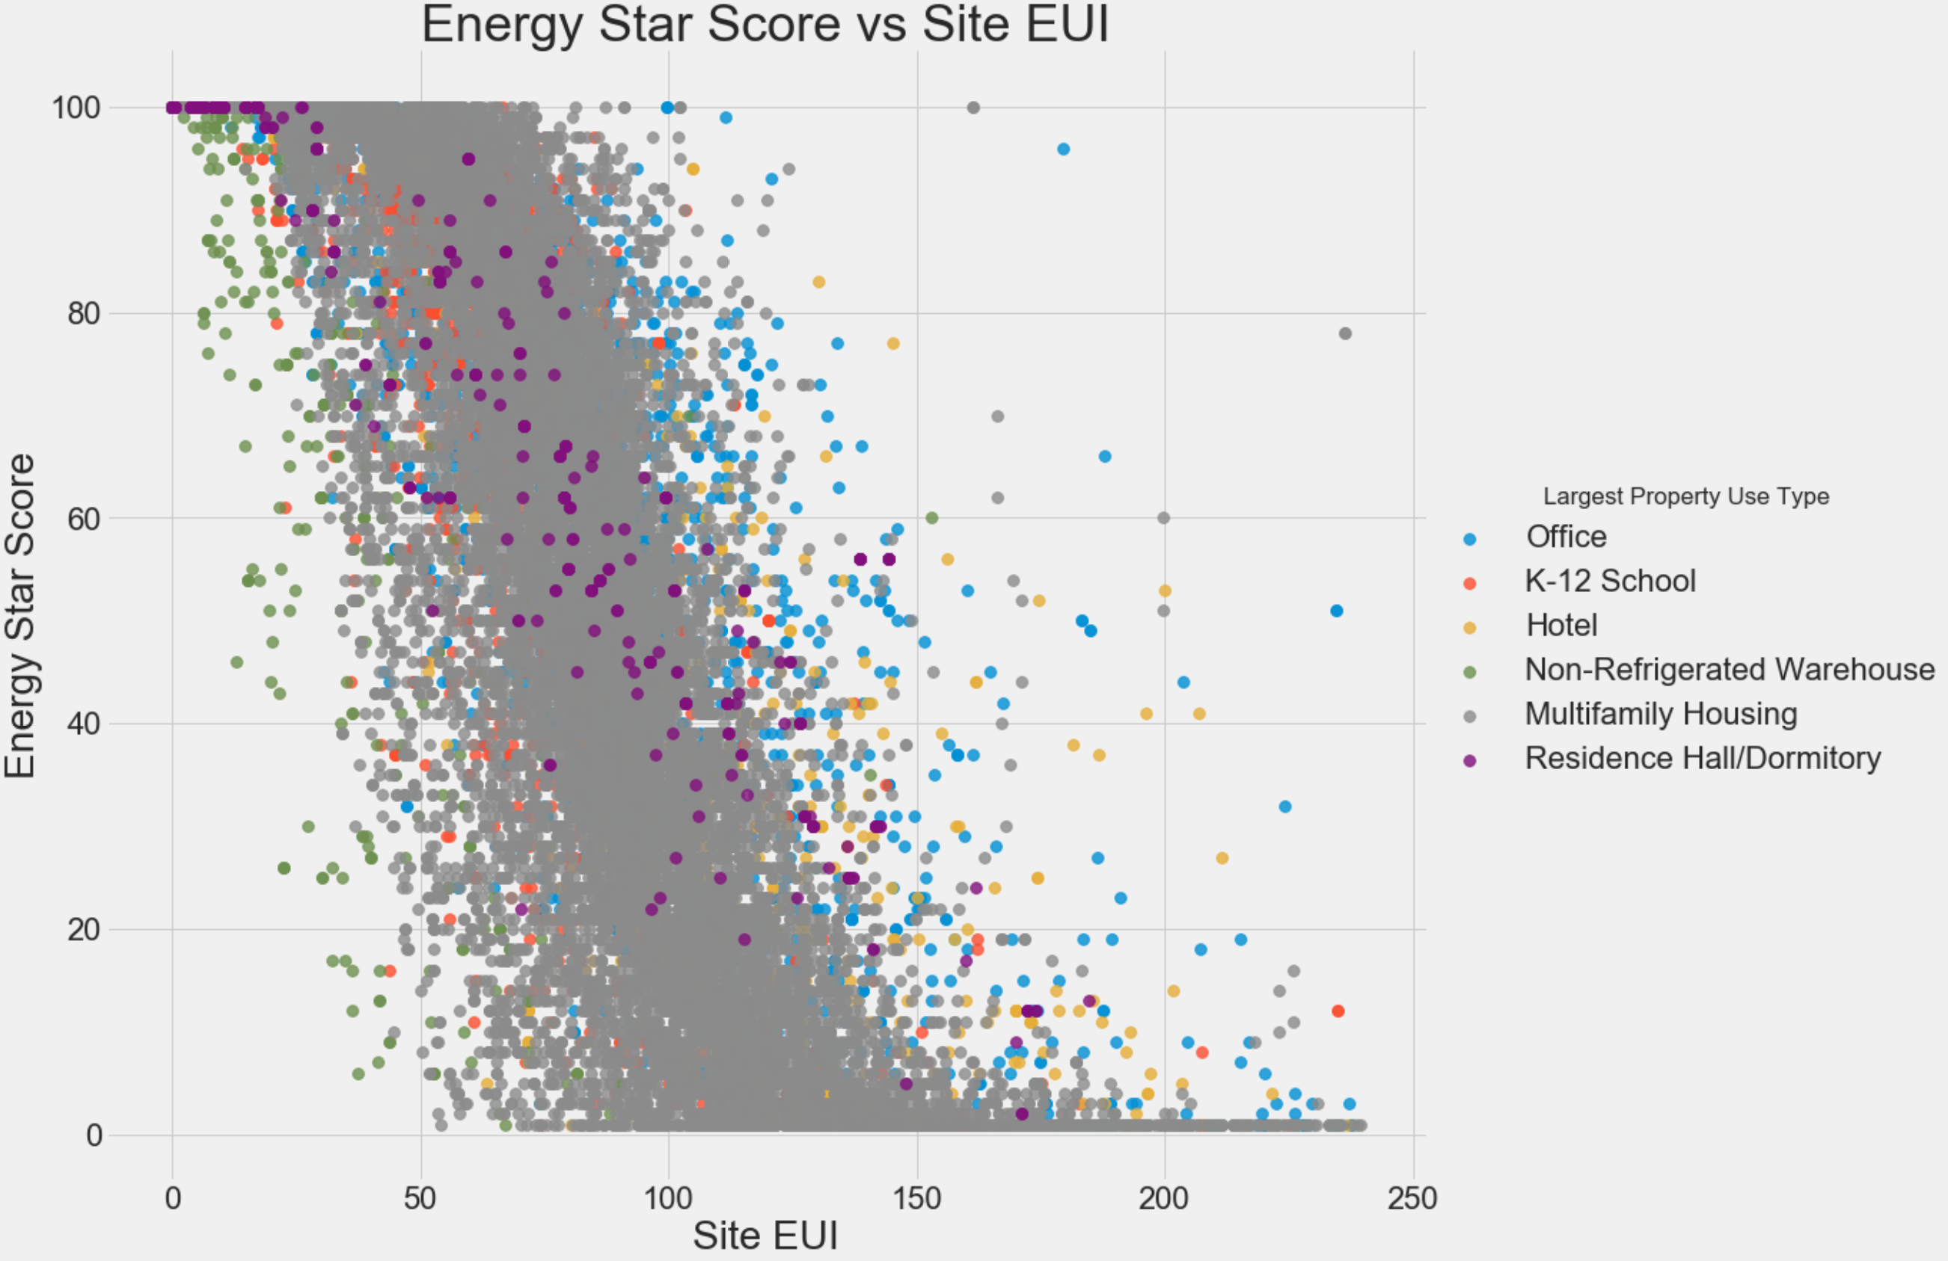
Energy Use Intensity (EUI) is highly correlated with target variable
Energy Star Score shows similar pattern for different properties' EUI (e.g., Office, Hotels)

Slide 10
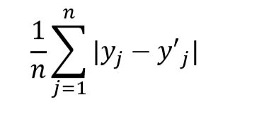
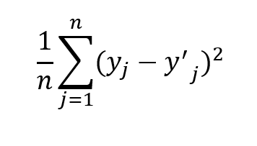
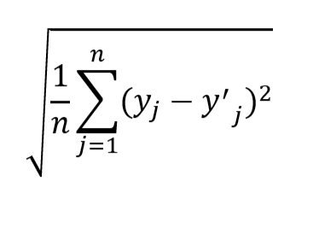

Model Implementation:
Distance : Euclidean Distance : $\sqrt[2]{\sum_{i=1}^{k}{(x_{i}}− y_{i})^{2}}$
Metric Used:
Mean Absolute Error :
Mean squared Error :
Root mean squared error (RMSE) :

Slide 11
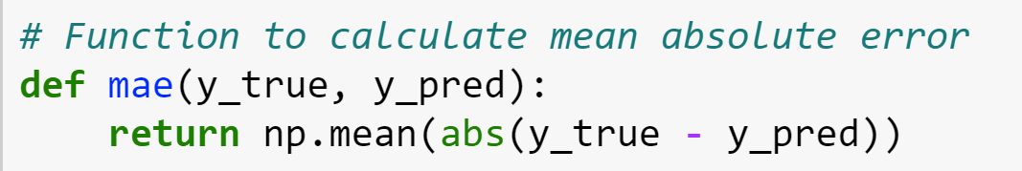
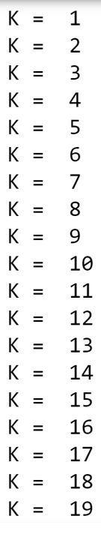
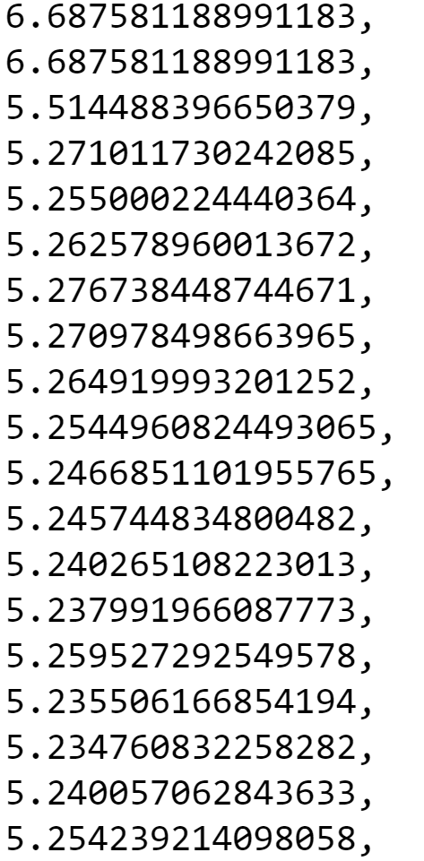
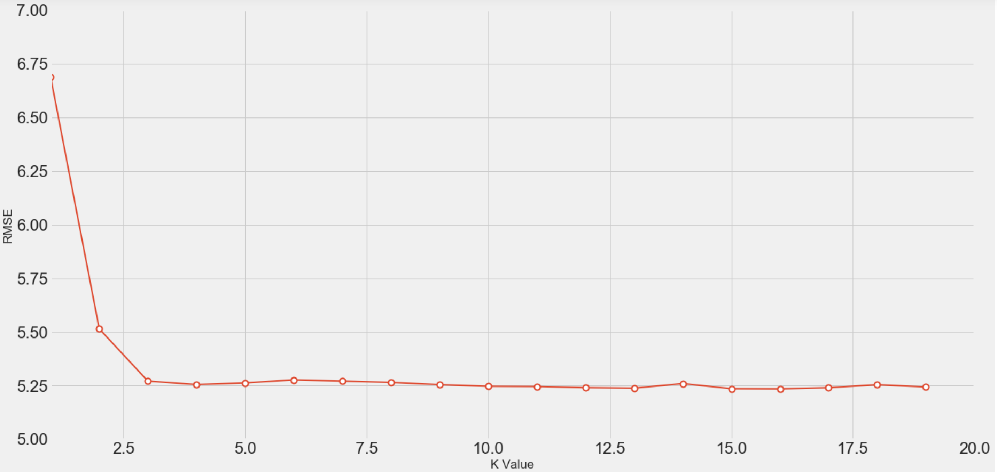
MAE results for different K value from Naive KNN method
Observations:
Best K value is above 3
Minimum error is 5.24

Slide 12
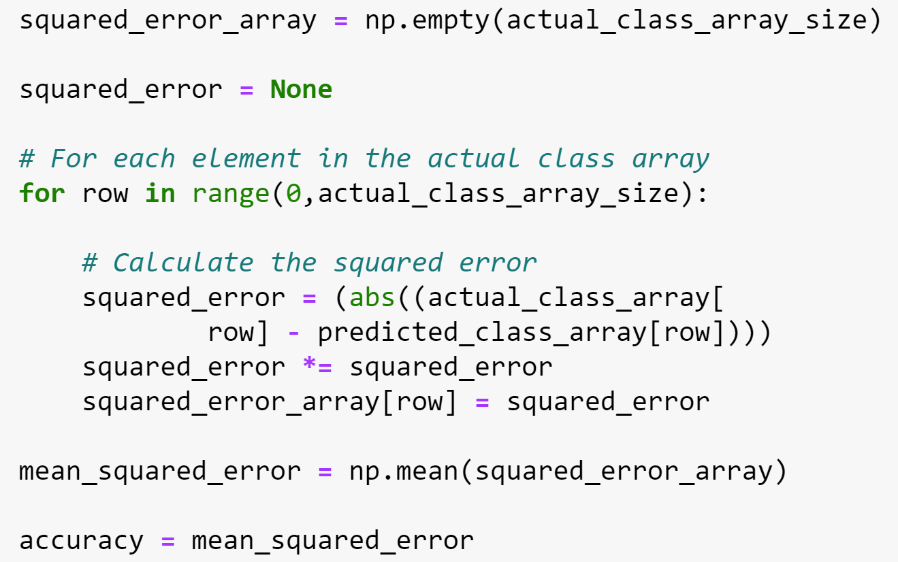
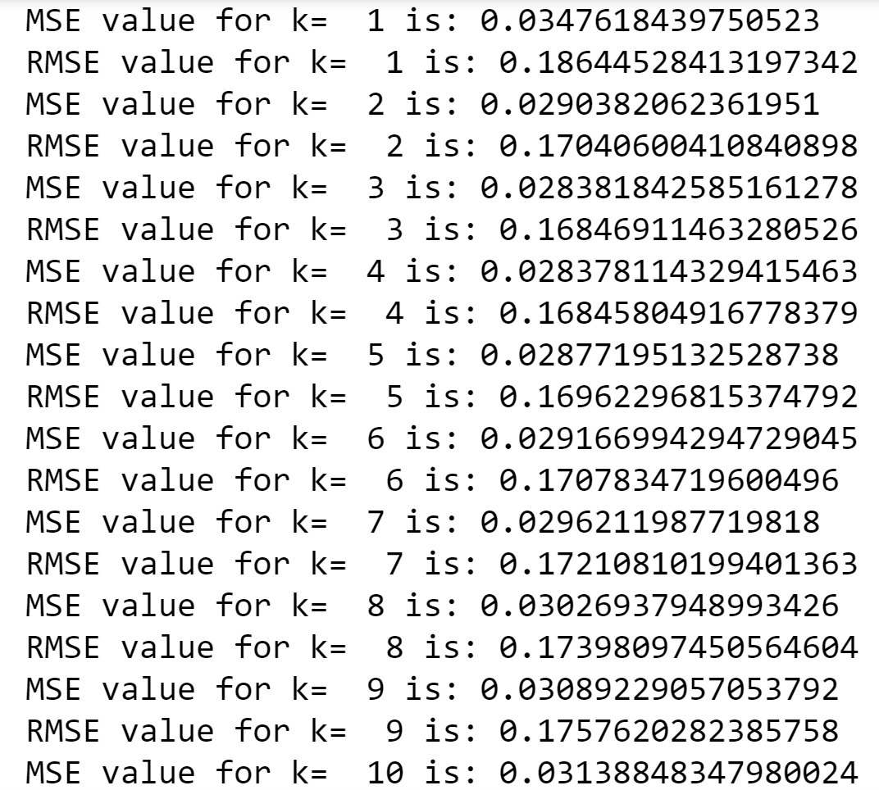
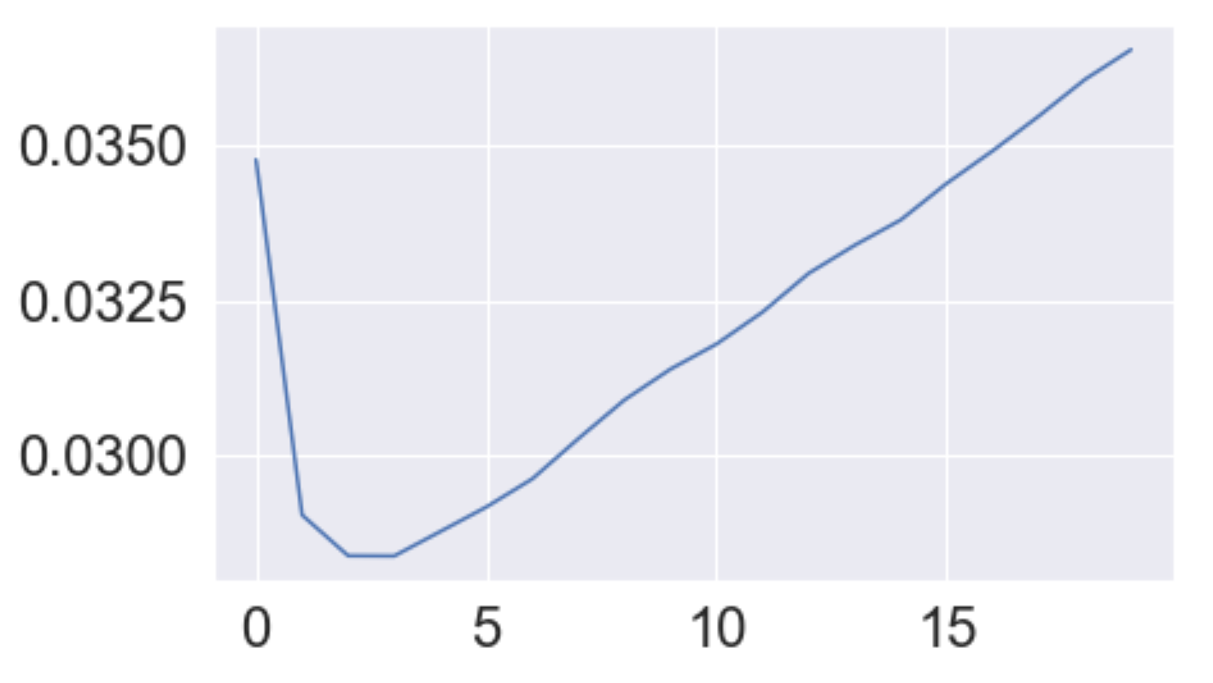
Metric : Mean Squared error
MSE
K-value
Best K value between 3 to 5
A nice elbow curve

Slide 13
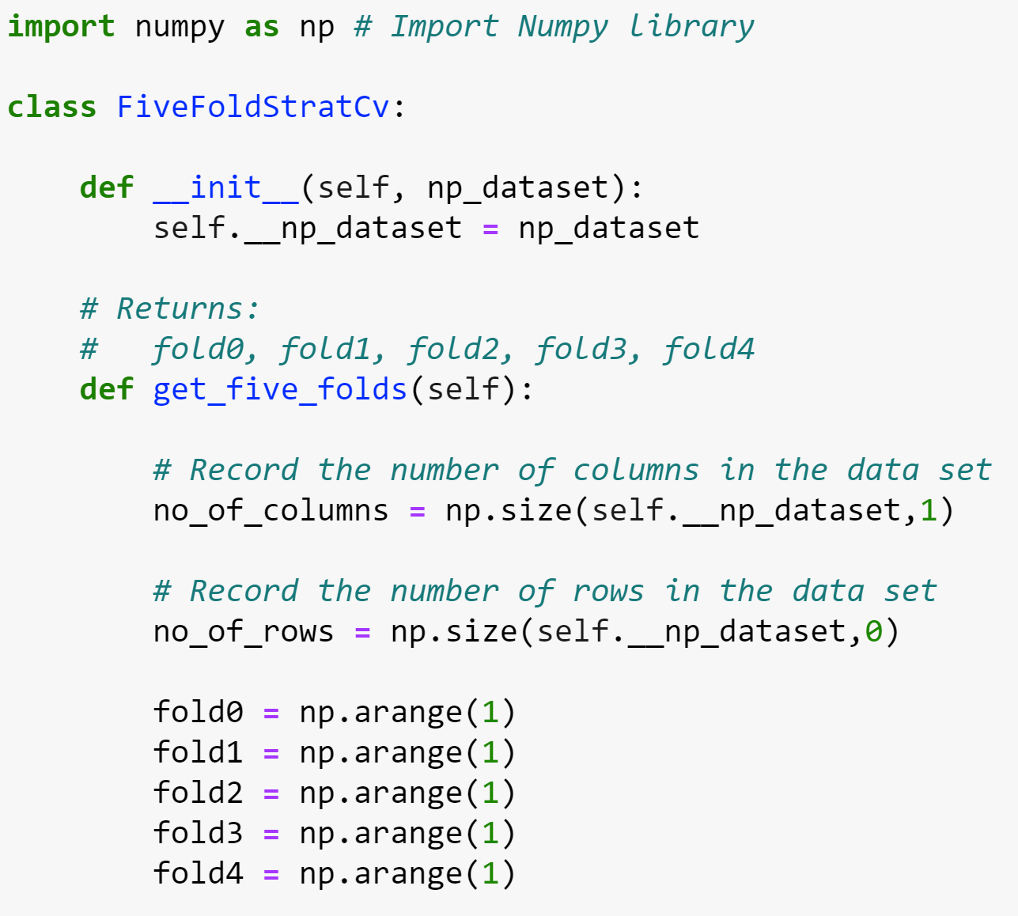
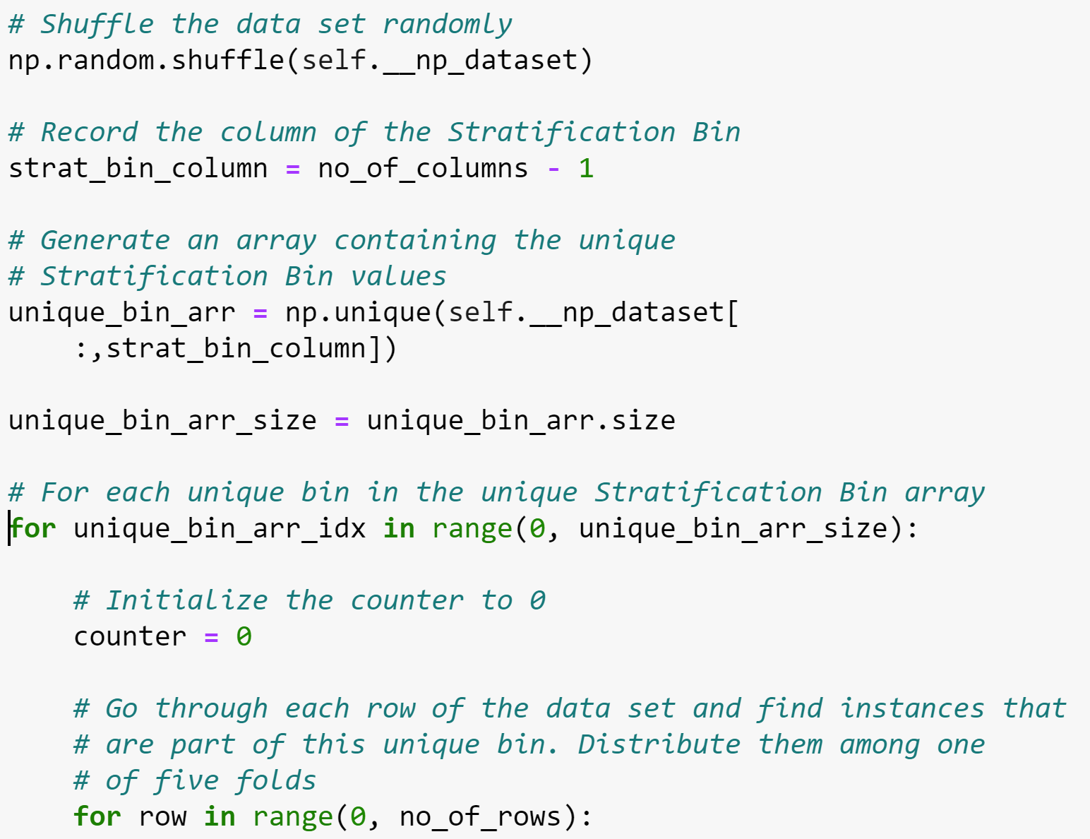

Cross Validation method with K fold
Mean squared error for 5 folds :
Metric chosen : neg_mean_squared_error
Mean of MSE : 0.028
Experiment 0 | Test | Train | Train | Train | Train
Experiment 1 | Train | Test | Train | Train | Train
Experiment 2 | Train | Train | Test | Train | Train
Experiment 3 | Train | Train | Train | Test | Train
Experiment 4 | Train | Train | Train | Train | Test

Slide 14
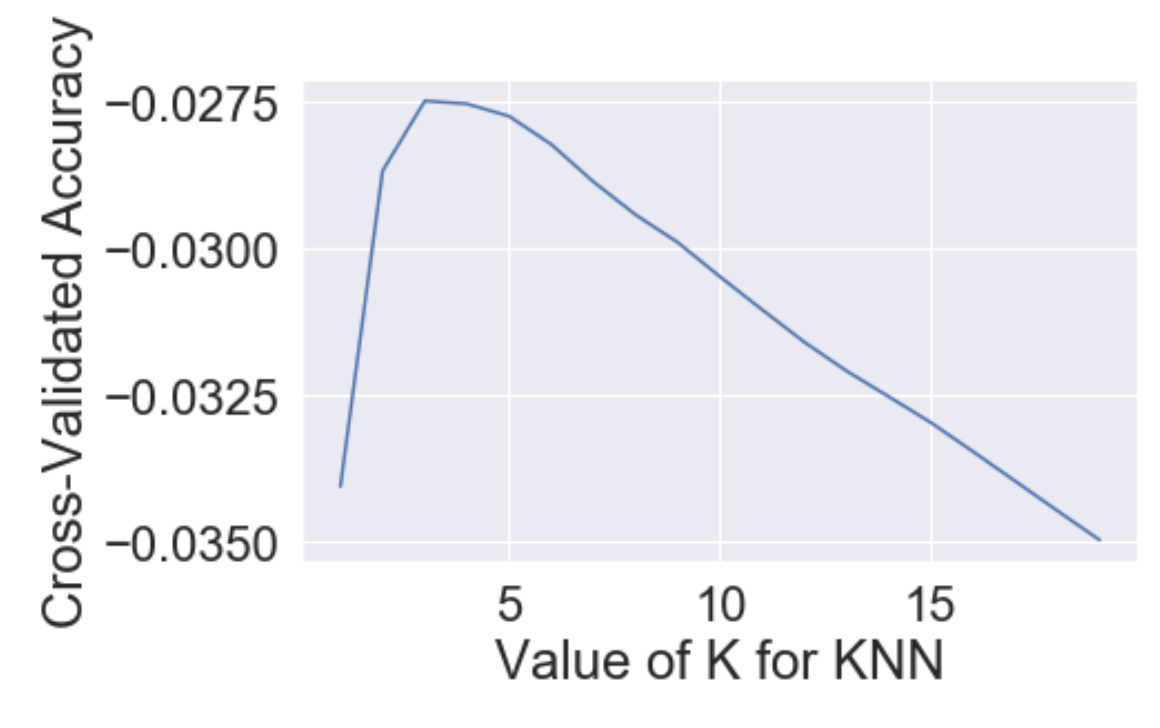
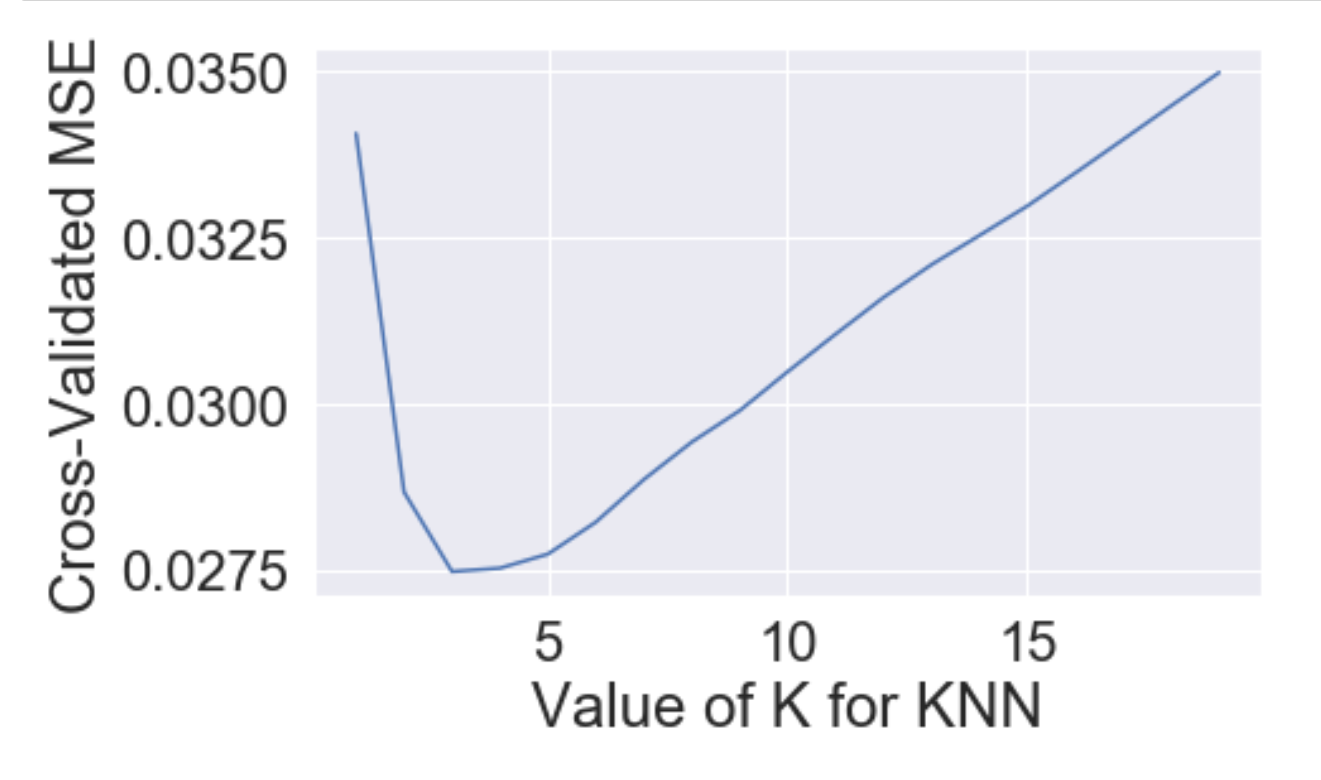
Results from Cross Validation with K fold
Metric: neg_mean_squared_error and Absolute mean square error
K value gives less error at 3 for both the case

Slide 15
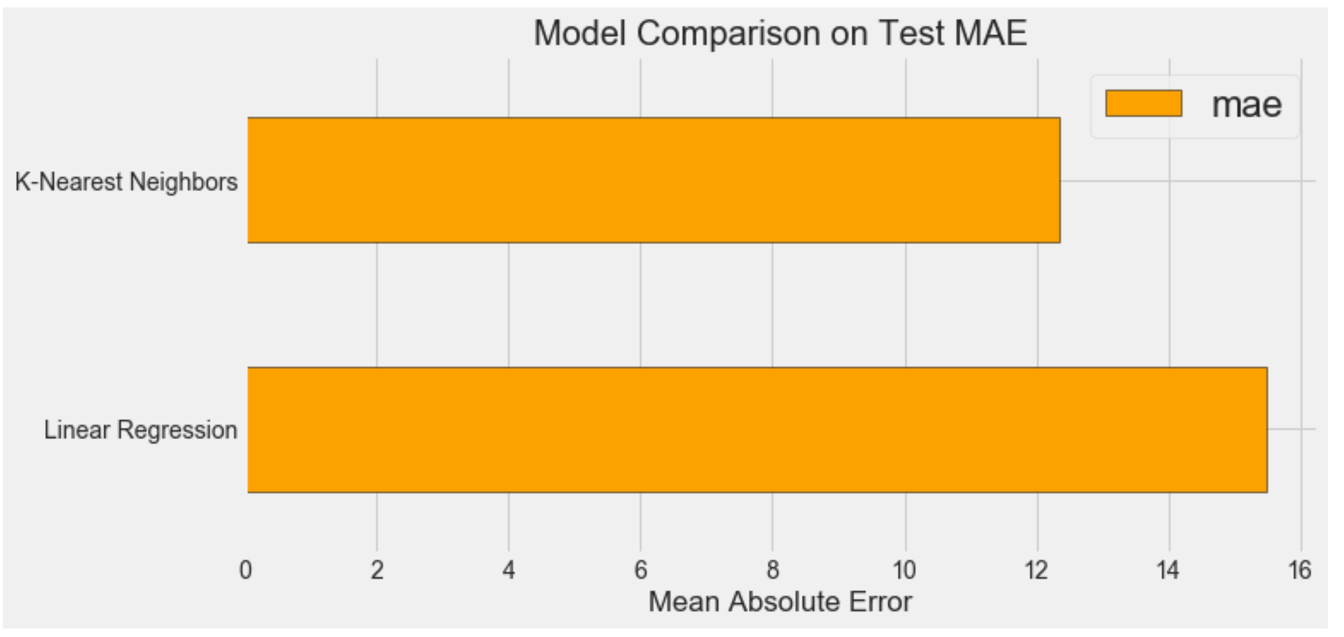
Comparison with other model

Slide 16
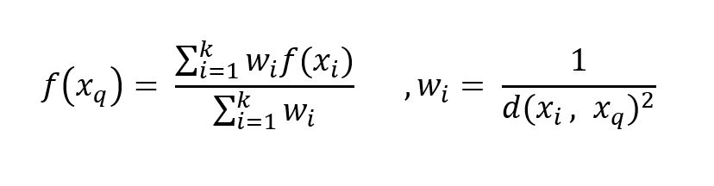
Weighted KNN regression
Selecting neighbor based on weight.

